Slide 3


James Westall
Arinco
Zooming down frosty hills with fibreglass strapped to my feet.
Delectable treats and eats
Azure

Slide 4
Zero to Hero
Prompt Engineering For Dummies

Slide 5
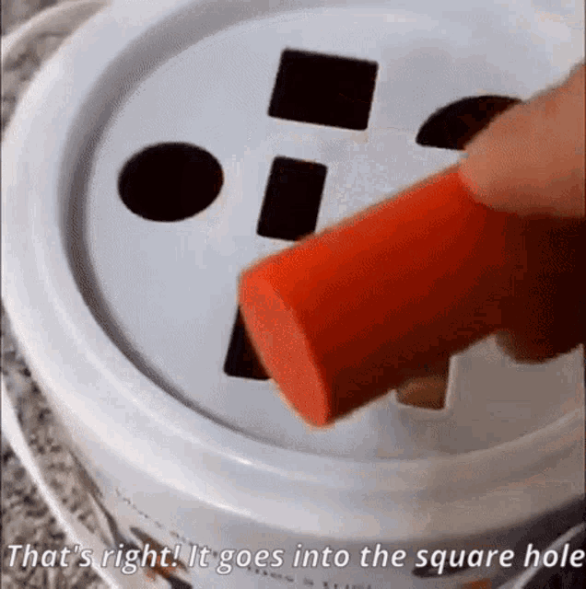
Large Language models just want to answer you.
So provide smarter INPUTs.

Slide 6
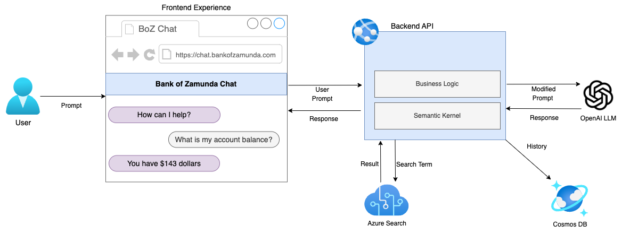
Retrieval Augmented Generation (RAG)

Slide 7
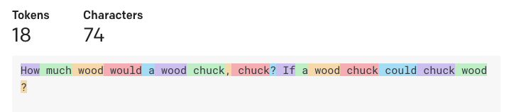
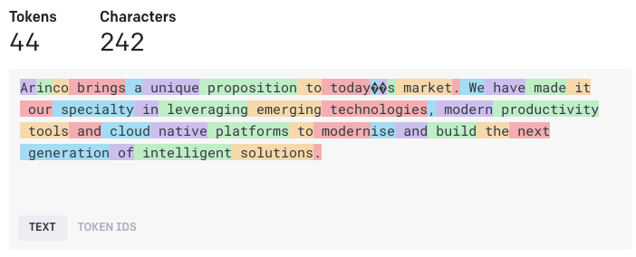
Understanding Tokens
Azure OpenAI is priced based on token usage, in 1000 token blocks.
Your prompt and response must be less than the model limits.
GPT-4 = 8192
GPT-3.5 = 4096
GPT-3 = 4096
As a general rule of thumb, 1 token ~= 4 chars in English
Limits currently do exist for tokens per hour (very high)

Slide 8
Basic Prompt Engineering
Simple & Complex Instructions: Simple Prompt: Write me a marketing slogan, summarising who Arinco is.
Complex Prompt : Write five marketing slogans, summarising who Arinco is. The slogan should make some reference to Artificial Intelligence and modernisation. Synonyms of these themes are acceptable replacement.
Response: Arinco are cloud native innovators, leveraging AI technology to modernise your ecosystem Usage Scenario: Creative license, non restrictive scenarios with assumed GPT knowledge
Primary Content/Grounding.
Prompt: In computer science, the time complexity is the computational complexity that describes the amount of computer time it takes to run an algorithm. Time complexity is commonly estimated by [...] Summarize the previous text in a few sentences:
Response: Time complexity is a measure of how long an algorithm takes to run. It is typically expressed as a function of the size of the input. The most common measure is worst-case time complexity, which is the maximum amount of time required for inputs of a given size.
Usage Scenario:
Providing organisational input for prompts, ensuring your data is presented to GPT

Slide 9
Basic Prompt Engineering
Zero Shot: Prompt: Headline: Coach confident injury won't derail Warriors
Topic:
Response: The coach is confident that the injury won't derail the Warriors' season. The team is still focused on their goals and that they will continue to work hard to achieve them.
Usage Scenario:
Creative license, non restrictive scenarios
Few-Shot:
Prompt: Headline: Twins' Correa to use opt-out, test free agency
Topic: Baseball
Headline: Qatar World Cup to have zones for sobering up
Topic: Soccer
Headline: Yates: Fantasy football intel for Week 6
Topic: Football
Headline: Coach confident injury won't derail Warriors
Topic:
Response: Basketball
Usage Scenario:
Ensuring expected response format

Slide 10
SYSTEM (META) PROMPTS
Prompt: ArchieBot helps the company employees understand information about the Contoso organisation, product offerings, and questions about the employee handbook. Be brief in your answers. Instructions.
If asking a clarifying question to the user would help, ask the question.
You should decline to respond if a user asks about the following topics: Free Ducks at the park, Violence, Sexual Content, If birds are real
If you decline to respond you should refer the employee to “hr@contoso.com” for an answer
For tabular information return it as an html table. Do not return markdown format.
<User Prompt>
Usage Scenario:
Defining complex sets of rules which your LLM must follow.

Slide 11
Bringing it all together
OpenAI GPT Tokens
<|im_start|>system
ArchieBot helps the company employees understand information about the Contoso organisation, product offerings, and questions about the employee handbook. Be brief in your answers. Instructions.
Answer ONLY with the facts listed in the list of sources below.
If there isn't enough information below, say you don't know.
Do not generate answers that don't use the sources below.
If asking a clarifying question to the user would help, ask the question.
For tabular information return it as an html table. Do not return markdown format.
Each source has a name followed by colon and the actual information, always include the source name for each fact you use in the response.
Use square brackets to reference the source, e.g. [info1.txt].
Don't combine sources, list each source separately, e.g. [info1.txt][info2.pdf].
System Prompt
Grounding Context
Sources: Contoso-Leave-Policy.pdf: <REMOVED FOR BREVITY>
<|im_end|>
<|im_start|>user Summarise the Contoso policy on leave requests. <|im_end|>
User Prompt
Prompt Start
<|im_start|>ArchieBot

Slide 12
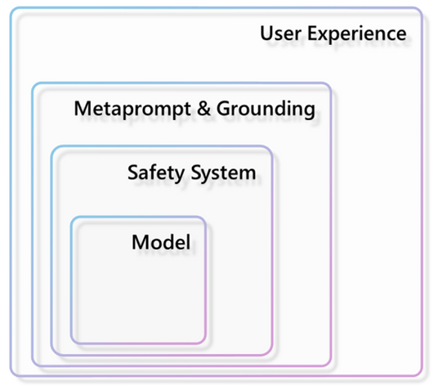
SECONDARY AREAS of Impact
User Experience
Model
Metaprompt & Grounding
Model
Safety System
Model

Slide 13
Should I Fine Tune My LLM?
No.*
*For about 999/1000 scenarios.

Slide 14
Vectors Are Better
Similarity Example - What is an amphibian?
1.000000 What is an amphibian?
0.937651 A frog is an amphibian.
0.902491 Amphibians are four-limbed and ectothermic vertebrates of the class Amphibia.
0.873569 Cos'è un anfibio?
0.866632 Frogs, toads, and salamanders are all examples.
0.857454 A frog is green.
0.842596 They are four-limbed and ectothermic vertebrates.
0.802171 A dog is a mammal.
0.784479 It's not easy bein' green.
0.778341 A tree is green.
0.756669 A dog is a man's best friend.
0.734219 You ain't never had a friend like me.
0.721176 Rachel, Monica, Phoebe, Joey, Chandler, Ross

Slide 15
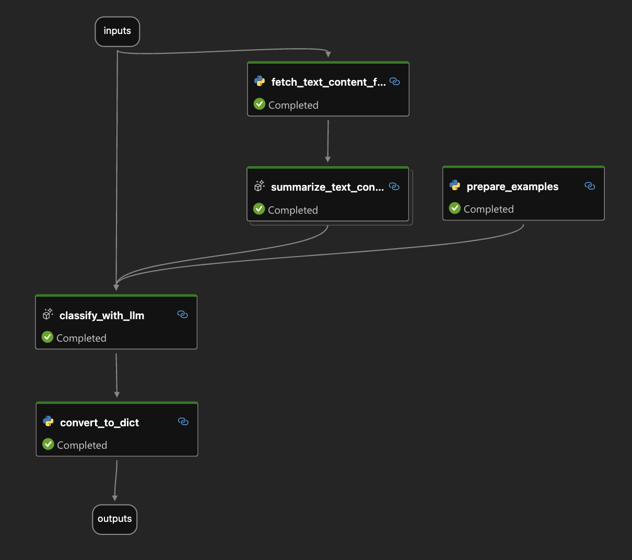

Evaluating Prompts
Measuring prompt performance is hard.
In public facing scenarios you should be doing this.

